Slide 1
Math 8
Chapter 9
Volume of 3D Solids

Slide 2
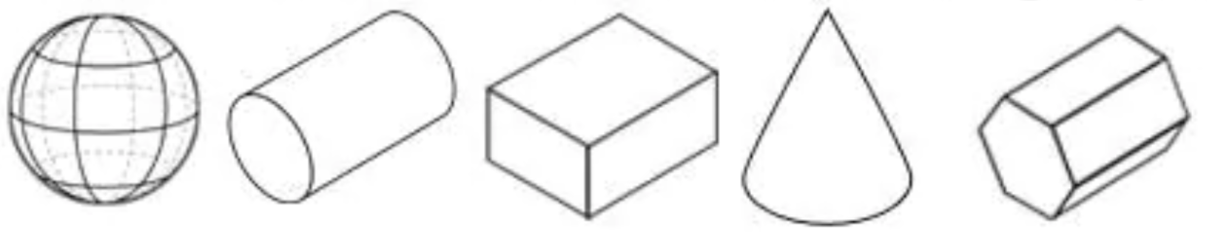
Q: Which of the following is not a prism?
A
B
C
D
E

Slide 3




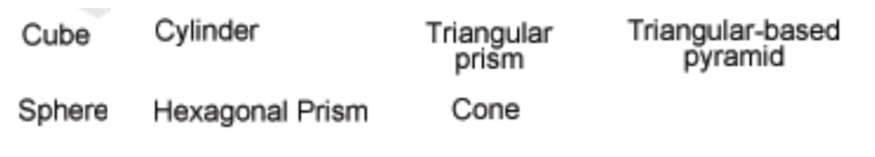
Match each solid with the corresponding name:

Slide 4
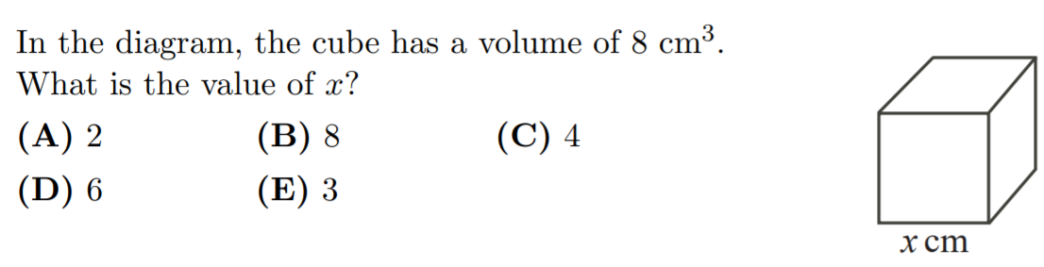

Slide 5
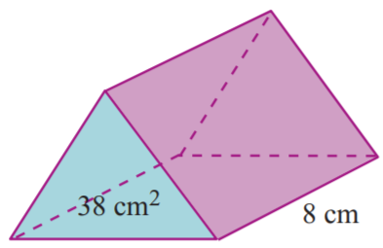
Given the area of the base, which expression will give the volume of the solid?

Slide 6
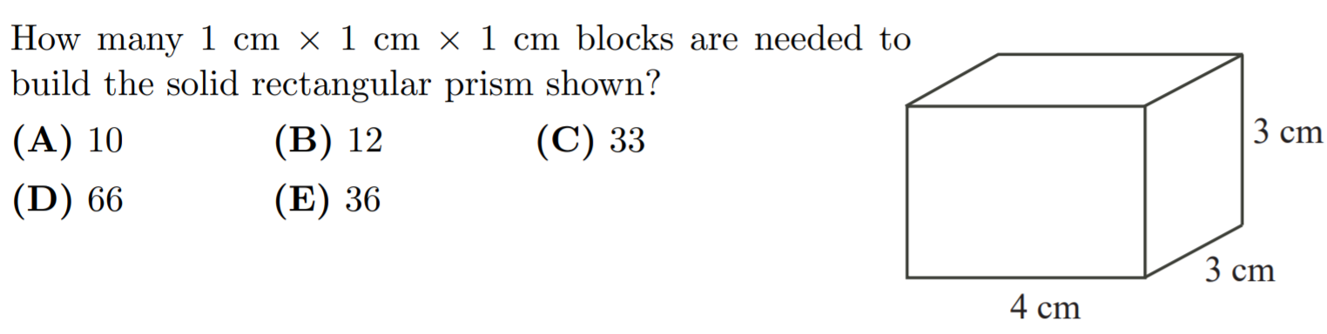

Slide 7
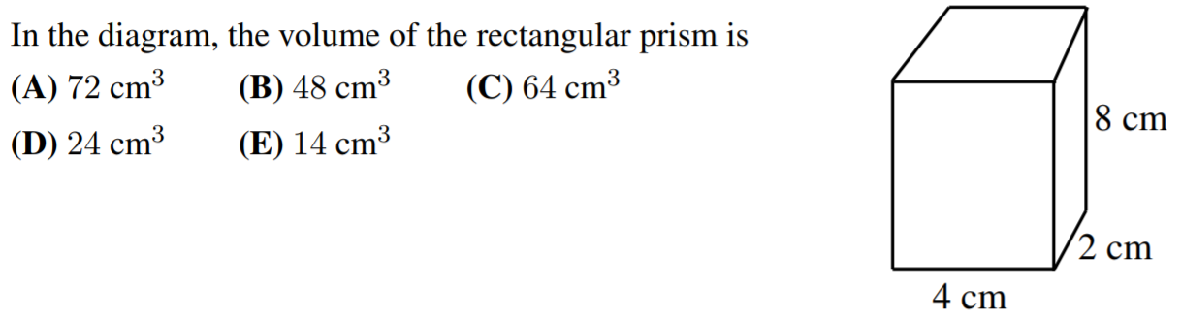

Slide 8
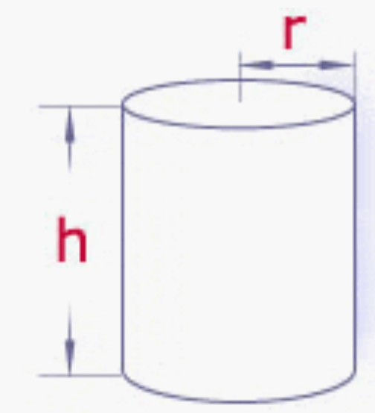
Q: Which of the following is the formula is for the volume of a cylinder?

Slide 9
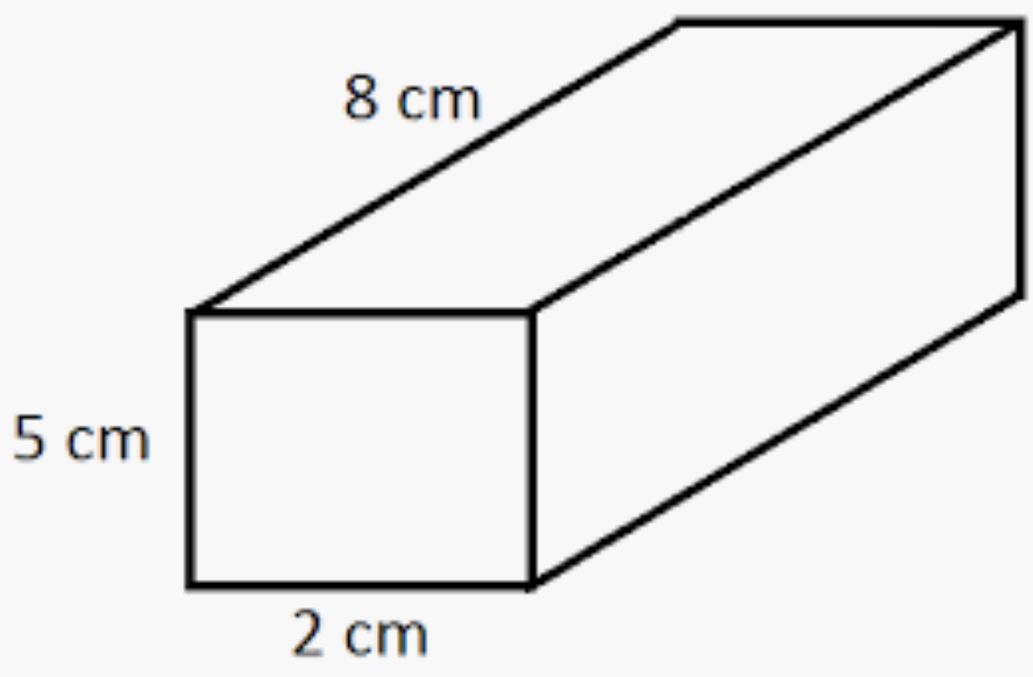
Which of the following is the correct solution for the volume of the prism?

Slide 10
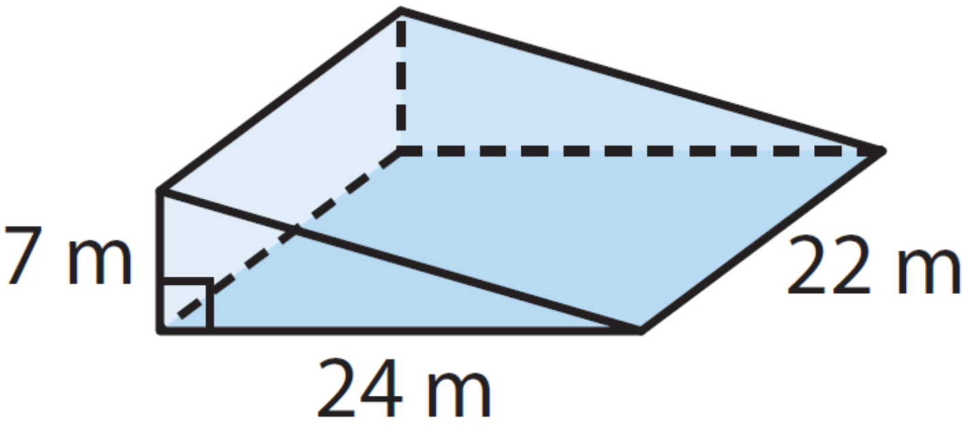
Which of the following is the correct solution for the volume of the prism?

Slide 11
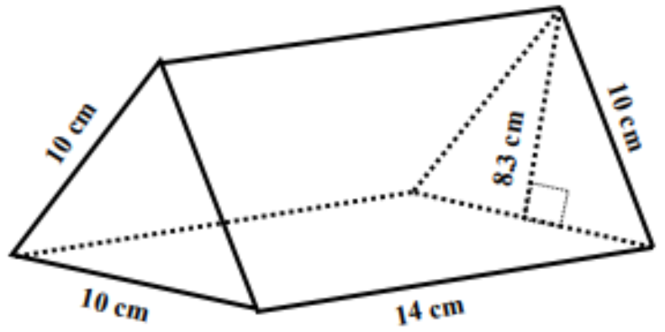
Which of the following is the correct solution for the volume of the prism?

Slide 12
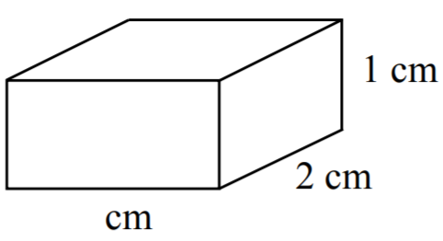
If the volume of this prism is 16cm³, what is the length of the missing side?

Slide 13
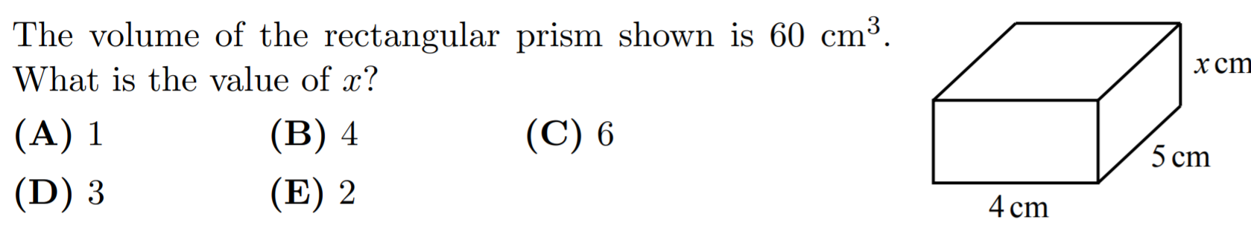

Slide 14
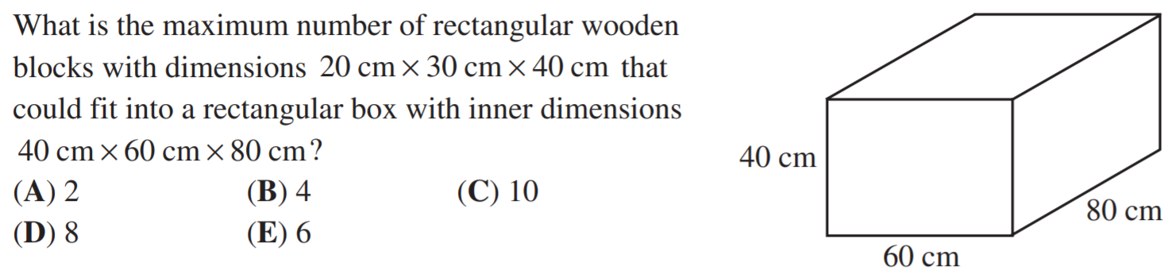

Slide 15
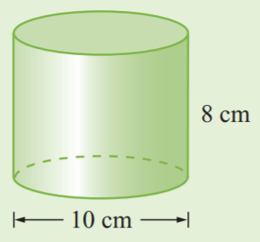
What is the volume of the following solid?
What is the volume of the following solid?
150πcm³
175π cm³
190π cm³
200π cm³
225π cm³
315π cm³

Slide 16
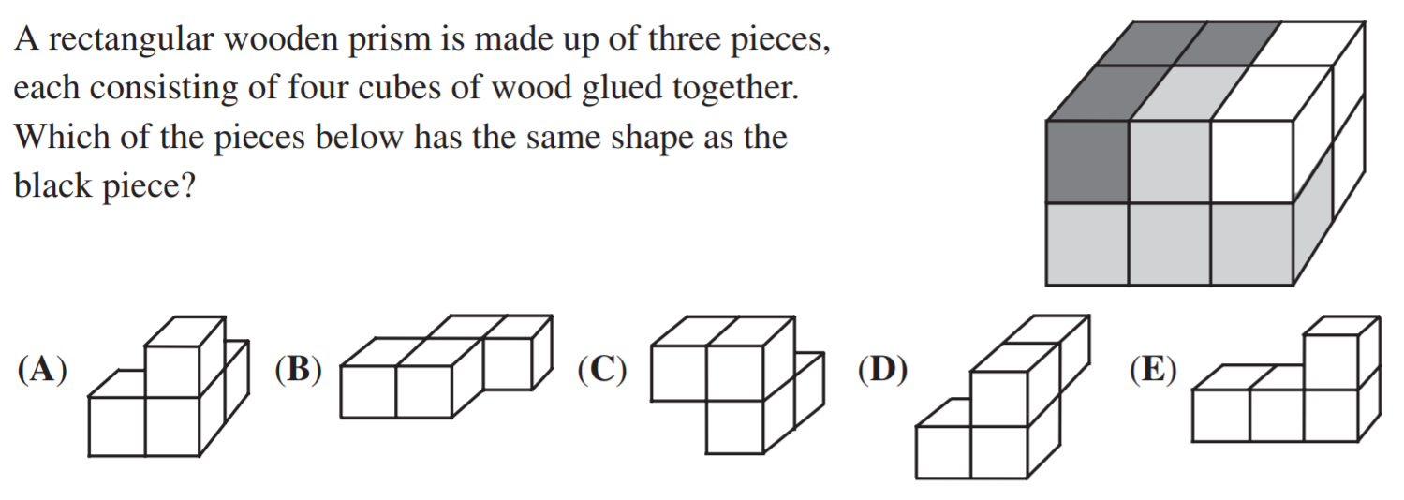

Slide 17
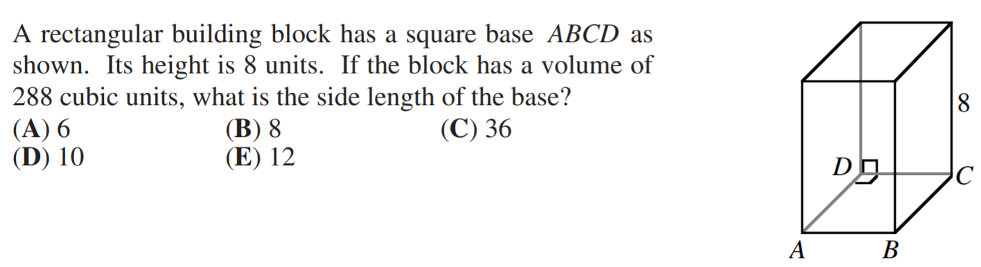

Slide 18
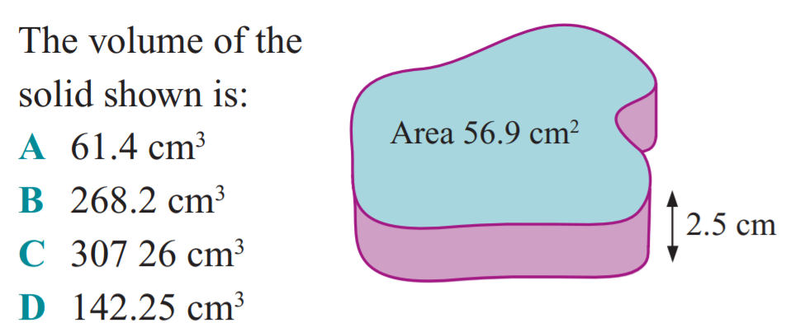

Slide 19
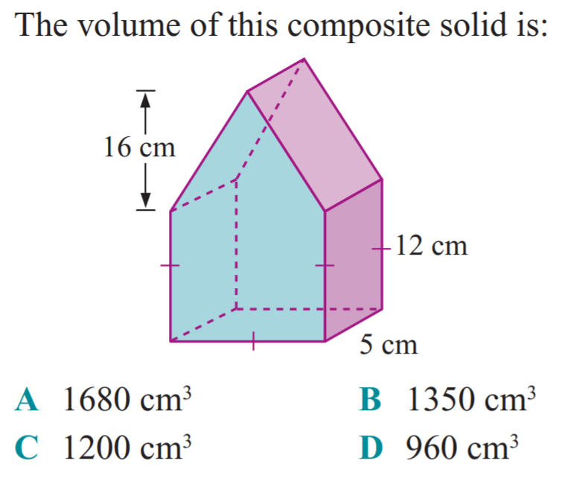

Slide 20
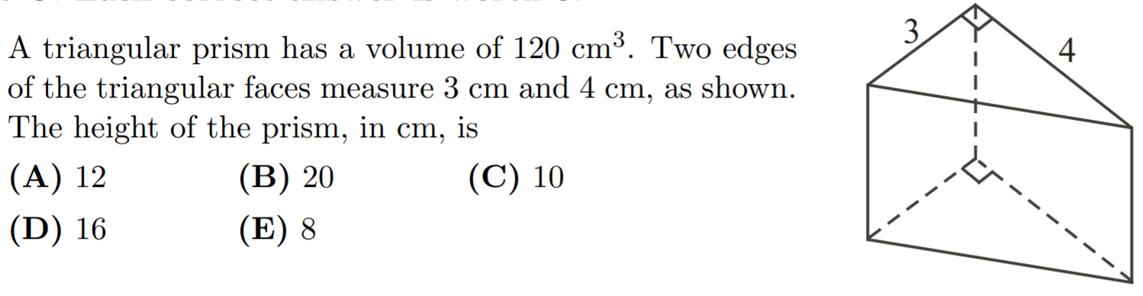

Slide 21
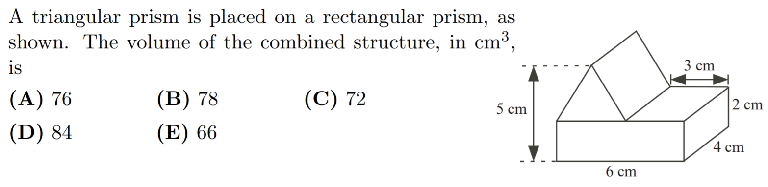

Slide 22
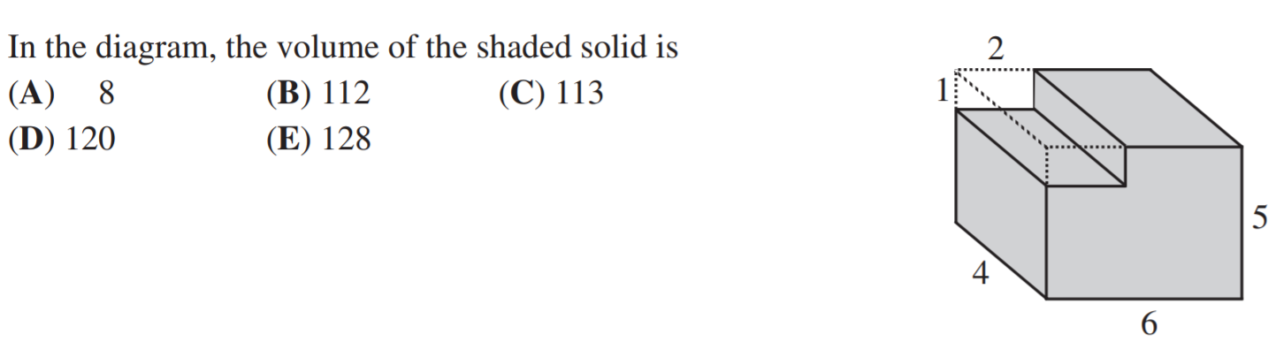

Slide 23
What is the volume of the prism shown?
4032cm³
4320 cm³
5040cm³
5184 cm³
4888cm³
4580cm³

Slide 24
A man digs a hole 6 inches deep for a post to hold his mailbox. If the square base of the post is 4 in. x 4 in., how many cubic inches of dirt will be displaced by the post?
96 (cubic inches)
Notes:
4*4*6 = 16*6=96

Slide 25
A step pyramid is formed by stacking successively smaller “steps” as illustrated in the drawing. If the edges of each square “step” have lengths 9,7,5,3, and 1, and each “step” is 1 unit high, find the number of cubic units in the volume of the pyramid.
1 ₃
₃ ₅
₅ ₇
₇ ₉
₉
Answer: 165 (units³)

Slide 26
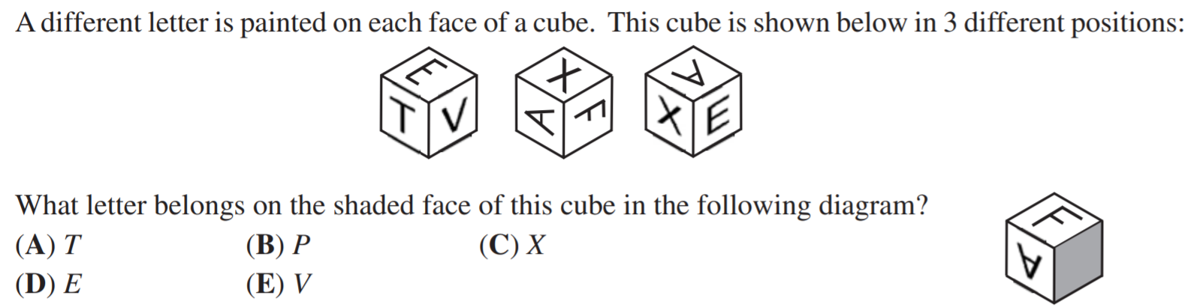

Slide 27
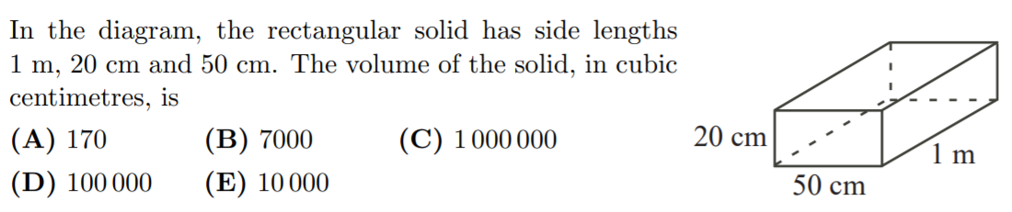

Slide 28
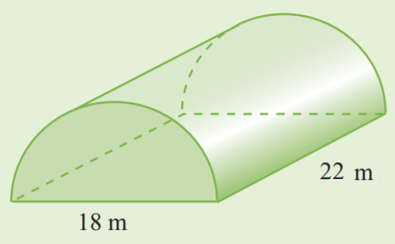
What is the volume of the following solid?
What is the volume of the following solid?
1394cm³
1400.1 cm³
1830cm³
2799.2 cm³
2888cm³
3276cm³

Slide 29
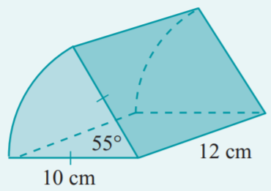
What is the volume of the following solid?
What is the volume of the following solid?
58cm³
144 cm³
120cm³
115cm³
288cm³
576cm³

Slide 30
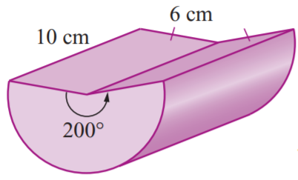
What is the volume of the following solid?
What is the volume of the following solid?
xxcm³
xxx cm³
xxx cm³
xxx cm³
xxx cm³
xxx cm³

Slide 31
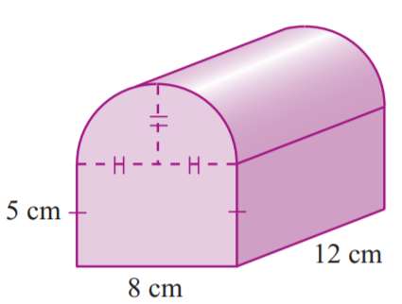
What is the volume of the following solid?
What is the volume of the following solid?
xxcm³
xxx cm³
xxx cm³
xxx cm³
xxx cm³
xxx cm³

Slide 32
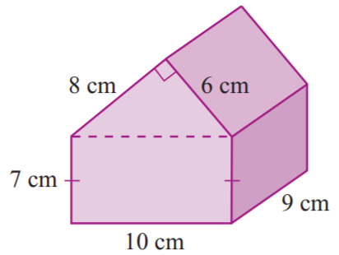
What is the volume of the following solid?
What is the volume of the following solid?
xxcm³
xxx cm³
xxx cm³
xxx cm³
xxx cm³
xxx cm³

Slide 33
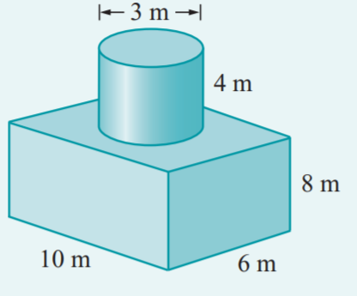
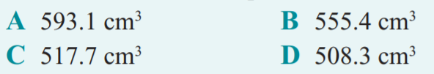
What is the volume of the following solid?

Slide 34
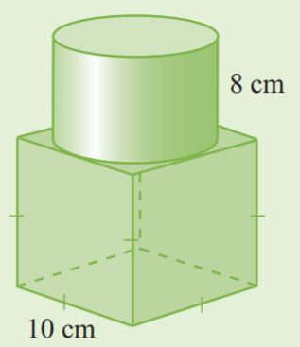
What is the volume of the following solid?
950cm³
1890 cm³
890cm³
1600cm³
1260cm³
1628cm³

Slide 35
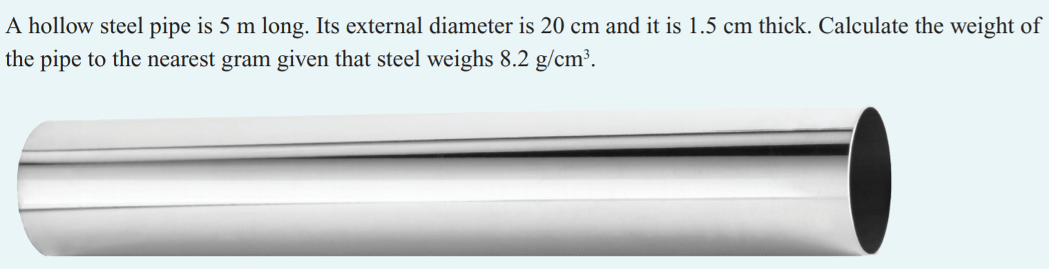

Slide 36
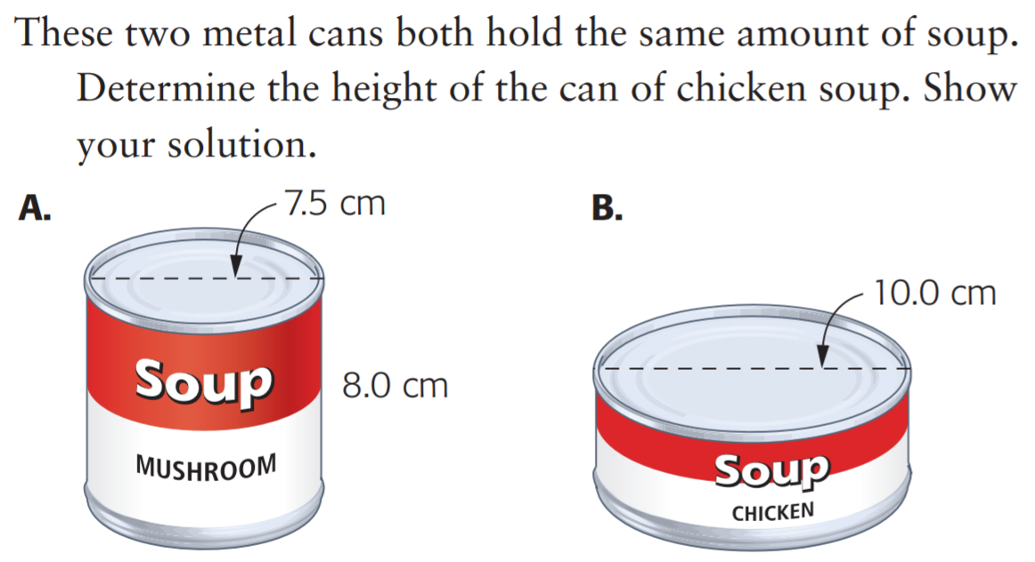

Slide 37
